Slide 1
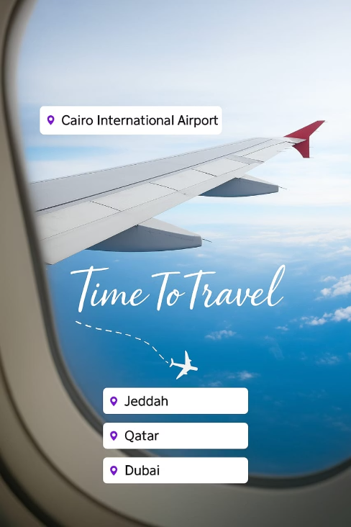


[Ra7al] - Flight Booking System
Notes:
1

Slide 2
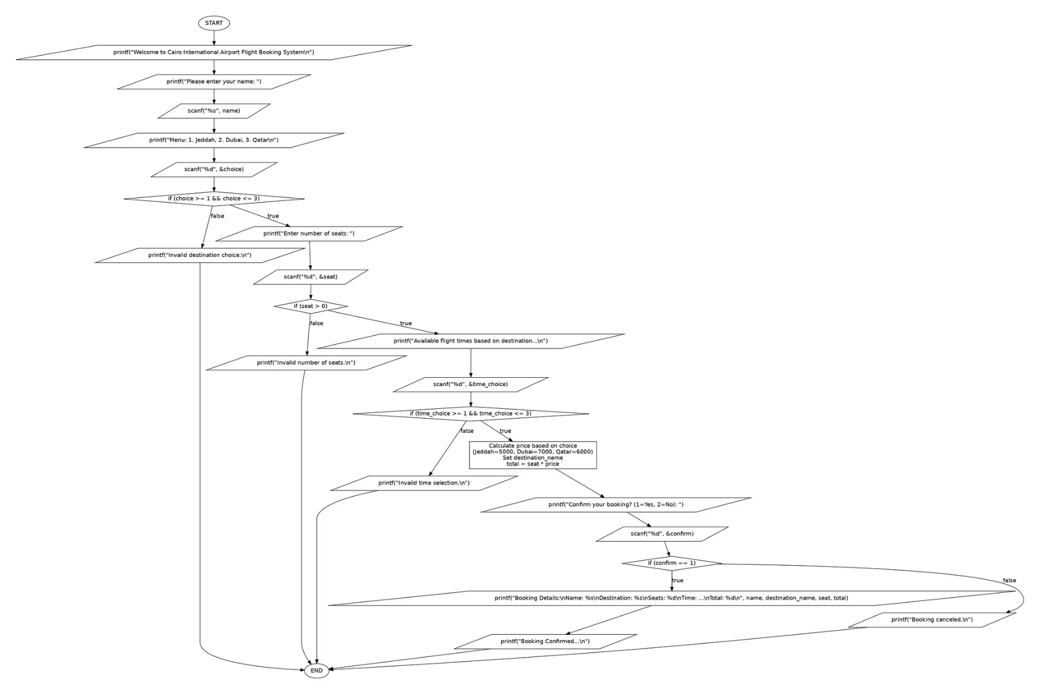
Notes:
2

Slide 3
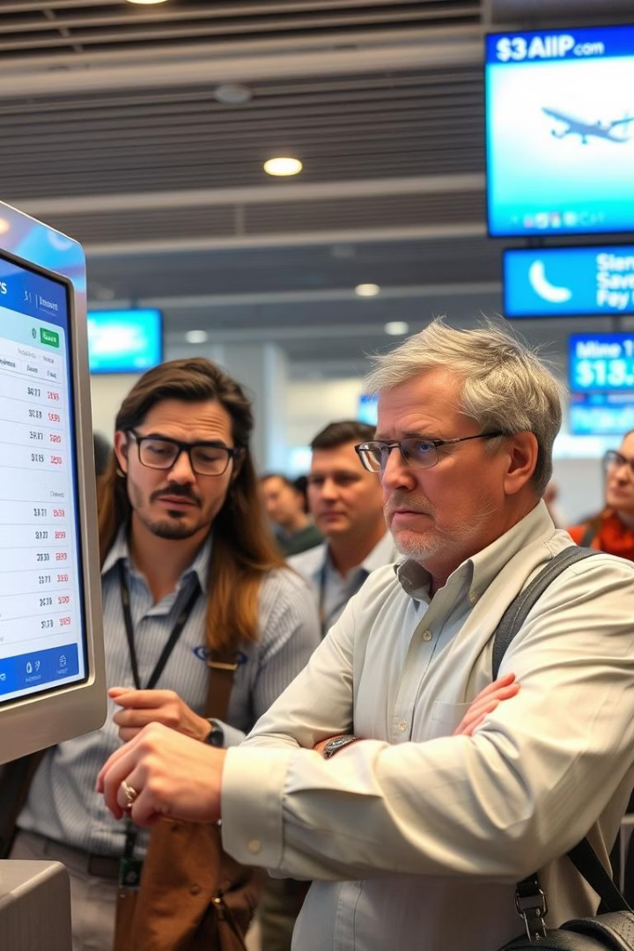
Problems Faced by Customers
Difficult Interface
Confusing and frustrating to use
Limited Access
Restrictions reduce usability
Slow Booking
Delays waste user time
Unsuitable Pricing
Prices often not competitive
Notes:
3

Slide 4
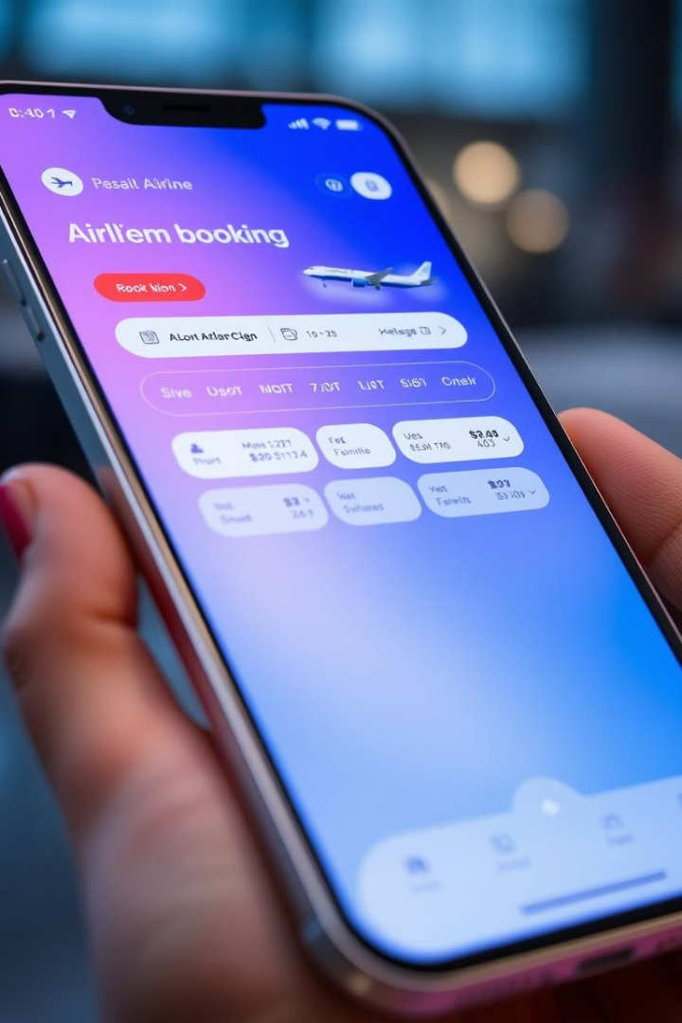
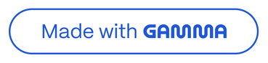
Our Solution
Streamlined booking steps.
Intuitive user interface.
Expanded access and options.
Competitive pricing model.
Notes:
4

Slide 5





How It Works
Enter Name
Enter Destination
Number of Seats
Select Time
Confirm Booking
Notes:
5

Slide 6





Benefits
Fast Booking
Streamlined UI
Suitable Pricing
Wide Options
Save time with quick steps
Intuitive and simple
Competitive and fair
Access multiple destinations
Notes:
6

Slide 7
Thank you for your interest
We appreciate your time and attention throughout this presentation.
Your interest in Ra7al inspires us to deliver excellence.
Notes:
7

